Slide 1
Dynamic Host Configuration Protocol (DHCP)
Dynamic Host Configuration Protocol (DHCP)
1

Slide 2
Dynamic Host Configuration Protocol (DHCP)
3

Slide 3
DHCP
It is a method for assigning Internet Protocol (IP) addresses
automatically to individual computers in an organization’s network
DHCP lets a network administrator supervise and distribute IP addresses from a central point and automatically sends a new IP address when a computer is plugged into a different place in the network

Slide 4
Why DHCP?
Static vs Dynamic IP
Configuration parameters for network hosts
IP address
Subnet Mask
Gateway
Dns
Others..

Slide 5


Why Use DHCP?
DHCP reduces the complexity and amount of administrative work
by using automatic TCP/IP configuration
Manual TCP/IP Configuration
Automatic TCP/IP Configuration
IP addresses are entered manually
IP address could be entered incorrectly
Communication and network issues can result
Frequent computer moves
increase administrative effort
IP addresses are supplied automatically
Correct configuration information is ensured
Client configuration is updated automatically
A common source of network
problems is eliminated

Slide 6
Static Vs. Dynamic
Static DHCP Assignments:
These are configurations where specific IP addresses are manually assigned to devices based on their MAC addresses. While DHCP is typically dynamic, meaning it assigns IPs dynamically from a pool, static DHCP assignments reserve specific IPs for particular devices. This information might be stored in a configuration file or database.
Dynamic DHCP Leases: When a device connects to a network and requests an IP address, the DHCP server dynamically assigns an available IP address from its configured pool. The server maintains a dynamic table of leased IP addresses, associating them with the MAC addresses of the requesting devices. These leases expire after a defined period, allowing IPs to be reused.

Slide 7
Limitations of DHCP
When DHCP server is unavailable, client is unable to access enterprises network
Your machine name does not change when you get a new IP address
Uses UDP, an unreliable and insecure protocol.

Slide 8




Sample Network
DHCP Server
DHCP Clients
UDP Port 68
UDP Port 68
UDP Port 68
UDP Port 67
Router
Internet

Slide 9
Initial Message Flow
Server A
Client
Server B
Client attempts to discover available DHCP servers
DHCPDISCOVER
DHCPDISCOVER
Servers reply with offers
DHCPOFFER DHCPOFFER
Client collects offers and decides which offer to accept
Client broadcasts request for
one of the received offers
DHCPREQUEST
DHCPREQUEST
Server acknowledges client’s
use of IP address
Configuration complete
DHCPACK
Graceful shutdown
Client correctly releases use of IP address
DHCPRELEASE

Slide 10
DHCP Message Types
DHCP Message | Use
DHCPDISCOVER | Client broadcast to locate available servers
DHCPOFFER | Server to client response offering configuration parameters
DHCPREQUEST | Client broadcast requesting offered parameters
DHCPDECLINE | Client to server notification that IP address is in use
DHCPACK | Server to client response confirming a request
DHCPNAK | Server to client response denying a request
DHCPRELEASE | Client to server request to the server marks the network address as not allocated
DHCPINFORM | Client to server request for configuration parameters

Slide 11
Domain name system (DNS)

Slide 12
Domain name system (DNS)
Internet Directory Service
A client-server application that maps host names into their corresponding IP addresses
Mapping host names into their corresponding IP addresses is called name resolution or name translation or name mapping or address resolution
Why we need to use names instead of IP numbers?
IP addresses are difficult to remember
Problem: Network only understands numeric addresses
Solution:
Use alphanumeric names to refer to hosts
Add a distributed, hierarchical protocol (called DNS) to map between alphanumeric host names and IP addresses
IP addresses are unique Host names must be unique

Slide 13
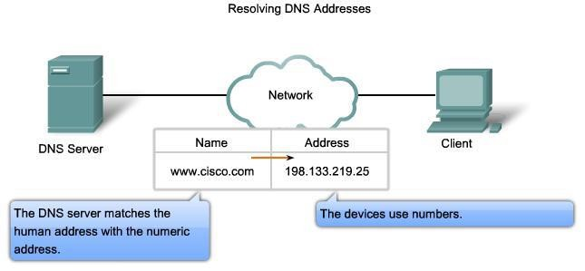
DNS services and protocols

Slide 14
WWW Service and HTTP
Steps:
URL is typed in the address bar
Browser checks with DNS server to convert it to an IP address
Connects to the server requested
Using HTTP or HTTPS protocol requirements, the browser sends a request to the server to ask for the desired html document (usually index.html)
The server sends the HTML code for the web page to the browser.
The browser interprets the HTML code and formats the page to fit the browser window

Slide 15
Domain Name System (DNS)
Properties of DNS
Hierarchical name space divided into zones
A DNS zone is a portion of the DNS namespace that is managed by a
specific organization
Hierarchy of DNS servers
Root Domain Server
Top-level domain (TLD) servers
Authoritative DNS servers

Slide 16
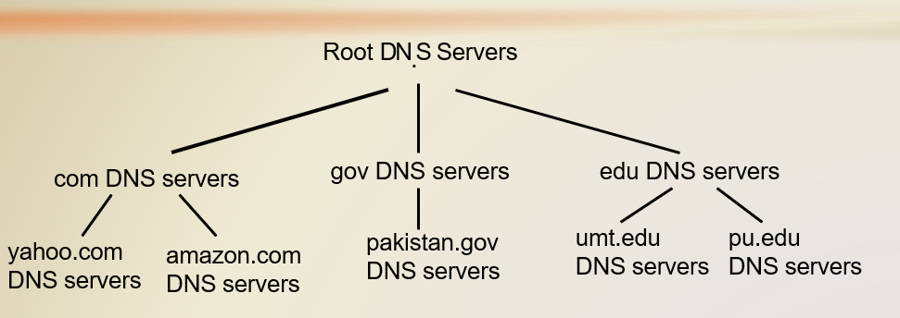
Domain Name System (DNS)
Client wants IP for www.amazon.com;
Client queries root server to find com DNS server
Client queries .com DNS server to get amazon.com DNS server
Client queries amazon.com DNS server to get IP address for

Slide 17
Domain name system (DNS)
Top-Level Domain (TLD) servers:
Generic domains (e.g., com, org, edu)
Country domains (e.g., uk, pk, jp)
Special domains (e.g., arpa)
Typically managed professionally
Network Solutions maintains servers for “com”
Educause maintains servers for “edu”
Authoritative DNS servers:
Provide public records for hosts at an organization
For the organization’s servers (e.g., Web and mail)
Can be maintained locally or by a service provider

Slide 18
Local DNS Name Server
Each ISP (residential ISP, company, university) has one
Also called “default name server”
When host makes DNS query, query is sent to its local DNS server
Has local cache of recent name-to-address translation

Slide 19
DNS: Root Name Servers
Contacted by local name server that can not resolve name
Root name server:
Contacts authoritative name server if name mapping not known
Gets mapping
Returns mapping to local name server

Slide 20
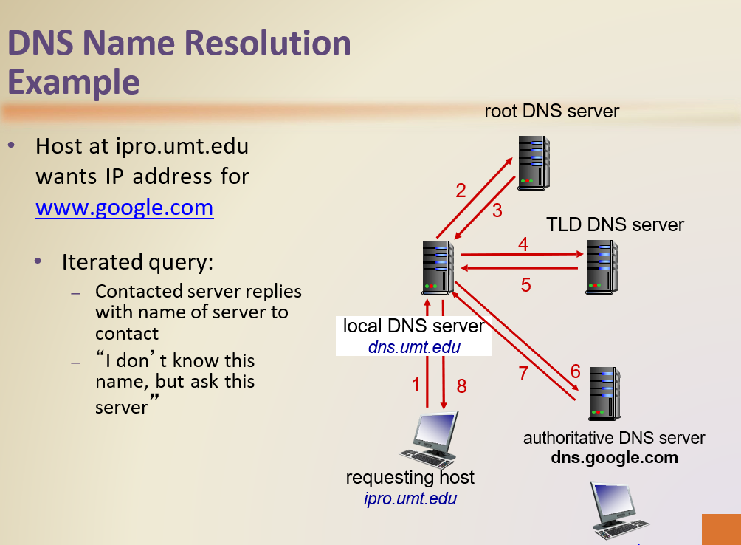

Slide 21
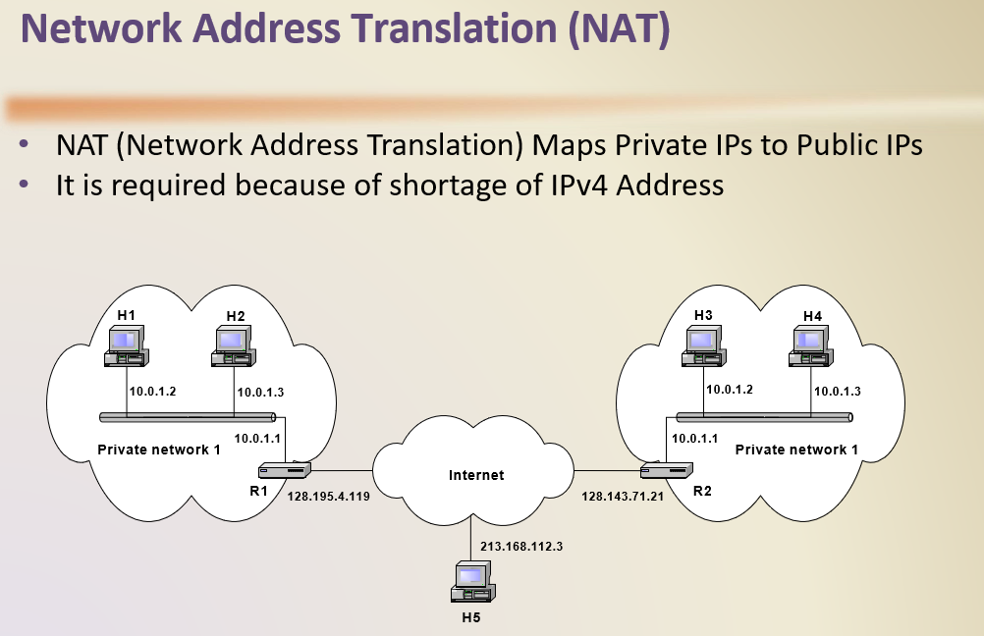

Slide 22
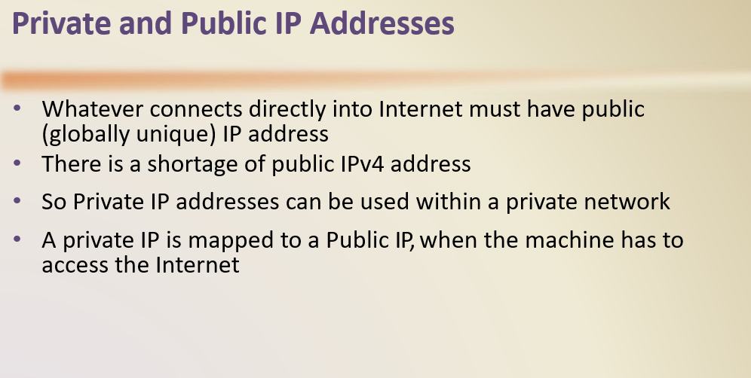

Slide 23
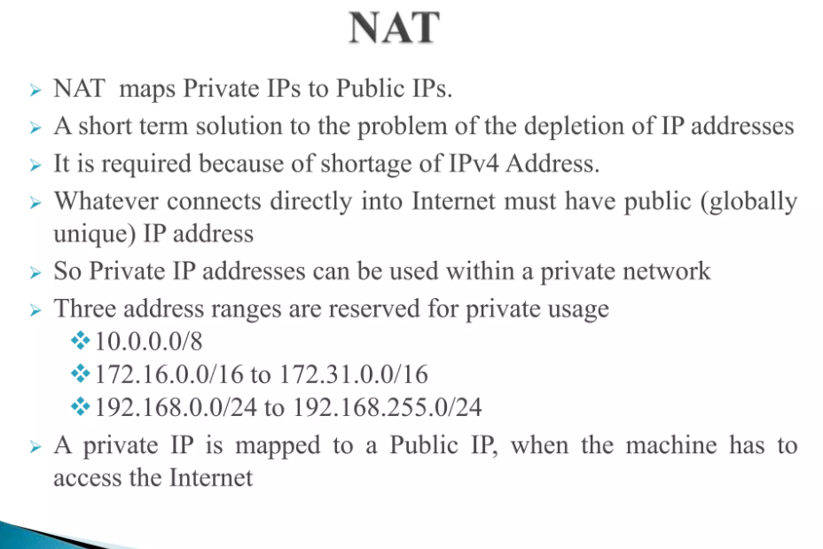

Slide 24
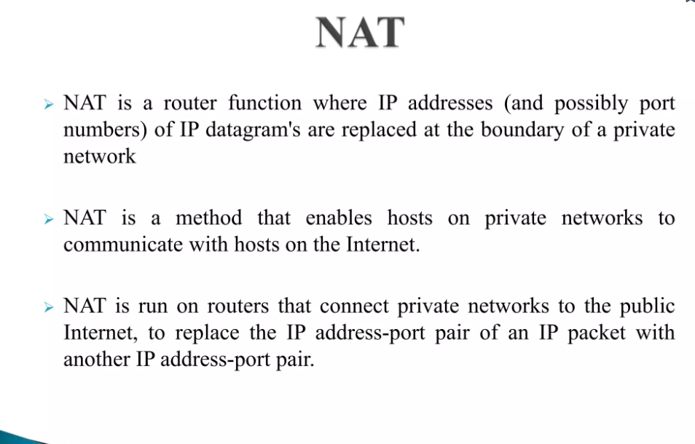

Slide 25
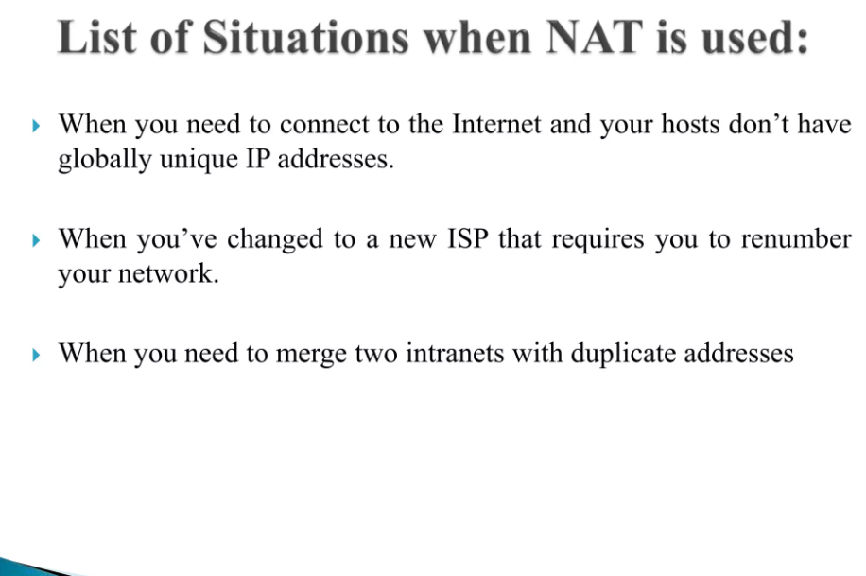

Slide 26
